Slide 1

Clean Code, A handbook of agile software craftsmenship
Robert C. Martin

Slide 2
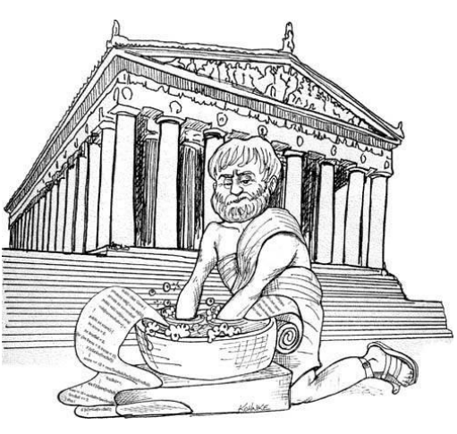
What is this book about?
It’s about code, obviously. But why do you need to know about clean code in the first place?
You would be reading this book for two reasons.
First, you are a programmer.
Second, you want to be a better programmer. (We need better programmers)
You will encounter lots of code in this book.
Look at code from every different direction.
Look down at it from the top, up at it from the bottom, and through it from the
inside out.
By the time you are done, you’ll be able to tell the difference between good code and
bad code.

Slide 3
Why do you need to know how to write code?
One might argue that writing code is no longer the issue; that we should be concerned about models and requirements instead.
Some even suggested that we are close to the end of code. That soon all code will be generated instead of written.
Nonsense! We will never be rid of code, because code represents the details of the requirements.
At some level those details cannot be ignored or abstracted; they have to be specified.
And specifying requirements in such detail that a machine can execute them is called programming.
Such a specification is code.
Remember that code is really the language in which we ultimately express the requirements.

Slide 4
Bad code
What does define a bad code?
Bad code is like cavity, if you don’t treat it in time, it can destroy your whole app.
There was this one company that, in the late 80s, wrote a killer app. It was very popular, and lots of professionals bought and used it. But then the release cycles began to stretch. Bugs were not repaired from one release to the next. Load times grew and crashes increased.
The company short time after that went out of business.
The reason that happened was, because the developers had rushed the product to market and had made a huge mess in the code.
As they added more features the code got worse until they simply could not manage it any longer.
It was the bad code that brought the company down.

Slide 5
Why do you write bad code?
Have you ever been significantly impeded by bad code?
If you are a programmer of any experience then you’ve felt this impediment many times.
There is a name for it, it’s called wading.
We wade through bad code. We slog through a morass of tangled brambles and hidden pitfalls.
We struggle to find our way, hoping for some hint, some clue, of what’s going on; but all we see is more and more senseless code.
We’ve all been impeded by bad code. So then why do you write it?
Some might say they’ve done it in rush. Perhaps some might felt that they didn’t have enough time to do a good job; that their boss would be angry with them, that the deadline is approaching, etc.
At the end of the day if it works it works, it doesn’t matter how, or why it works right?
Well you’re completely wrong about that one.

Slide 6
What is Clean Code?
There are probably as many definitions as there are programmers.
This is what some well-known and deeply experienced programmers have said about clean code:
Bjarne Stroustrup, inventor of C++ and author of The C++ Programming Language said:
“I like my code to be elegant and efficient. The logic should be straightforward to make it hard for bugs to hide, the dependencies minimal to ease maintenance, error handling complete according to an articulated strategy, and performance close to optimal so as not to tempt people to make the code messy with unprincipled optimizations. Clean code does one thing well.”
Grady Booch, author of Object Oriented Analysis and Design with Applications
“Clean code is simple and direct. Clean code reads like well-written prose. Clean code never obscures the designer’s intent but rather is full of crisp abstractions and straightforward lines of control.”
This and more will be shown on the next slide.

Slide 7
Some more quotes from experienced programmers
“Big” Dave Thomas, founder of OTI, godfather of the Eclipse strategy
“Clean code can be read, and enhanced by a developer other than its original author. It has unit and acceptance tests. It has meaningful names. It provides one way rather than many ways for doing one thing. It has minimal dependencies, which are explicitly defined, and provides a clear and minimal API. Code should be literate since depending on the language, not all necessary information can be expressed clearly in code alone.”
Michael Feathers, author of Working Effectively with Legacy Code
“I could list all of the qualities that I notice in clean code, but there is one overarching quality that leads to all of them. Clean code always looks like it was written by someone who cares. There is nothing obvious that you can do to make it better. All of those things were thought about by the code’s author, and if you try to imagine improvements, you’re led back to where you are, sitting in appreciation of the code someone left for you—code left by someone who cares deeply about the craft.”
There are many others who had something to say about clean code, but I will leave that in the book.
At the end of the day, it’d be wise to take a look at this, because it shows you the thought process of some good programmers and the tricks, techniques, and tools that they use.

Slide 8
Meaningful names
Names are everywhere in software. We name our variables, our functions, our arguments, classes and packages.
We name our source files, and directories.
We name our jar files, and war files, and ear files.
We name our git repositories, or we need a meaningful message for every commit that we push onto the git.
What follows are some simple rules for creating good names.

Slide 9
Rules for naming our files
Use Intention-Revealing Names
The name of a variable, function, or class, should answer all the big questions. It should tell you why it exists, what it does, how it is used.
If a name requires a comment, then the name does not reveal its intent.
Ex: int d; // Proslo vreme u danima
Avoid Disinformation
Programmers must avoid leaving false clues that obscure the meaning of code.
We should avoid words whose entrenched meanings vary from our intended meaning.
Ex: hp, aix, and sco would be poor variable names because they are the names of Unix platforms or variants.
Do not refer to a grouping of accounts as an accountList unless it’s actually a List.

Slide 10
Some other rules for naming our files.
Make Meaningful Distinctions
Programmers create problems for themselves when they write code solely to satisfy a compiler or interpreter.
For example, because you can’t use the same name to refer to two different things in the same scope, you might be tempted to change one name in an arbitrary way.
Sometimes this is done by misspelling one, leading to the surprising situation where correcting spelling errors leads to an inability to compile.
Use Pronounceable Names
Humans are good at words. A significant part of our brains is dedicated to the concept of words. And words are, by definition, pronounceable. It would be a shame not to take advantage of that huge portion of our brains that has evolved to deal with spoken language. So make your names pronounceable.
Ex: class DtaRcrd102 { … } // Bad name
Ex2: class removeAllFromList { … } // Good name
There are many other rules that explain more in depth, but I decided to use these for this presentation.

Slide 11
Conclusion
Writing a clean code helps you and everyone else, so why not learn how to write it.
What is actually a good code? Some of the most well-known and experienced programmers have shared their thought on this.
Use meaningful names when naming your code.
Learn the rules of naming your code.
Bad code can destroy your whole app, it can be unreadable, and it’s hard to fix later.

Slide 12
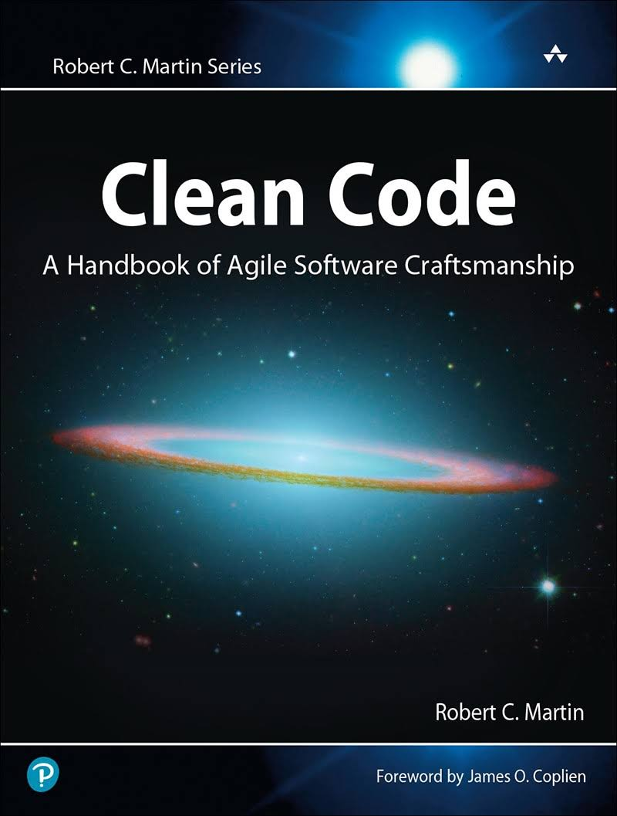
All of this, and more you can find in a book.
Clean Code, A handbook of Agile Software Craftsmenship
By Robert C. Martin.
Links to some of the sites that you can buy a book:
https://www.mikroknjiga.rs/store/prikaz.php?ref=978-86-7555-444-8
https://www.korisnaknjiga.com/clean-code-a-handbook-of-agile-software-craftsmanship-naslov-101320
https://www.knjizare-vulkan.rs/kompjuterska-literatura/60605-jasan-kod-clean-cod-prirucnik-za-pisanje-jasnih-programa
https://startit.rs/biblioteka-softver-developera-riznica-knjiga-za-ljude-koji-vole-kod/
https://www.amazon.com/Clean-Code-Handbook-Software-Craftsmanship/dp/0132350882

Slide 13
The end.
Made by Aleksa Cekic 4173.

